Slide 1

//Build// Mini 2015
Universal Windows Platform、Edge、Visual Studio Code、Cordova
Ian
2015.6.6

Slide 2


About Me
Microsoft MVP (ASP.NET)
TechDays 2014 講師
MVP 2015 微軟實戰課程日 講師
html5 & javascript程式開發實戰書籍共同作者
K.NET 社群創辦成員
Study4.TW 社群成員
www.dotblogs.com.tw/ian
Ian.msmvp@outlook.com

Slide 3
Agenda
Windows 10 Universal Windows Platform
Edge
Visual Studio
Cross Platform App - Cordova

Slide 4
Universal Windows Platform

Slide 5
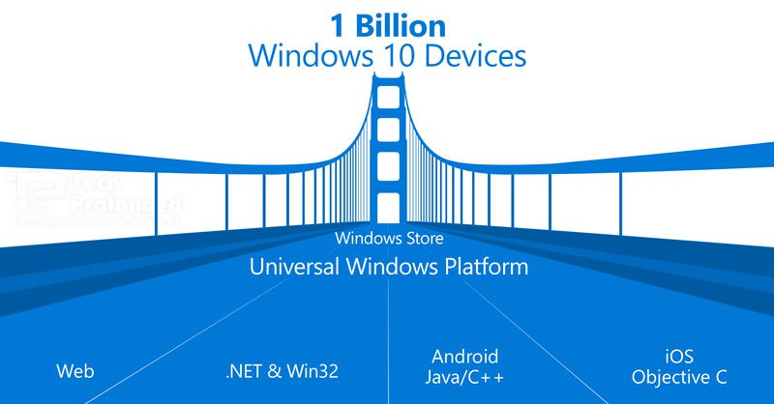
Windows 10
7月29日推出
http://windows.microsoft.com/zh-tw/windows/preview-iso

Slide 6
Windows 10
Home | Mobile | Pro | Eterprise | Education | Mobile Enterprise
PC、平板電腦 | 智慧型手機和小型平板電腦 | Base on Windows 10 Home for小型企業 | Base on Windows 10 Pro for 中大型企業 | Base on Windows 10 Enterprise for 學校職員、系統管理員、教師和學生設計的版本 | 針對企業客戶所使用的智慧型手機和小型平版電腦所設計
Windows 10 上市的第一年提供 Windows 7、Windows 8.1 和 Windows Phone 8.1 裝置免費升級
Windows 10 Home、Windows 10 Mobile 和 Windows 10 Pro 完整版。
http://blogs.technet.com/b/technet_taiwan/archive/2015/05/20/windows-10-editions-introduction.aspx

Slide 7







One store, one dev center
ONE APP PLATFORM
ONE STORE
ONE CORE OS
IoT
HoloLens
Surface Hub

Slide 8
Universal Windows Platform
Windows 8 Universal apps
Windows 8 (8.1)
Windows Phone
Universal Windows Platform (UWP)
手機、平板電腦、電腦，以及即將加入的 Xbox
Mobile
Desktop
Universal Windows Platform
Core APIs
IoT
Xbox
Holographic
Surface Hub

Slide 9
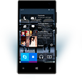

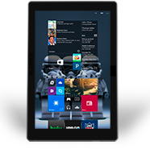
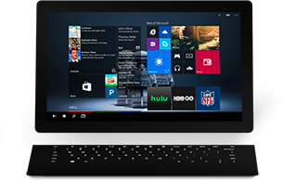

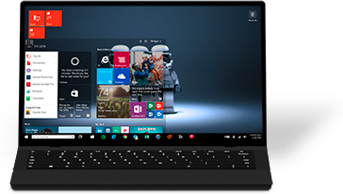

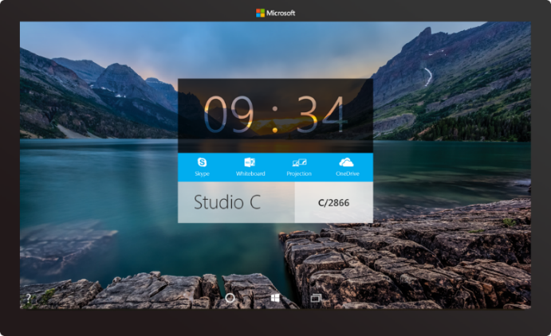

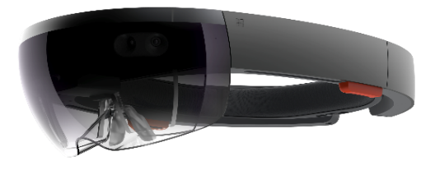



2-in-1s (Tablet or Laptop)
Classic Laptop
Desktops & All-in-Ones
Phone
Phablet
Small Tablet
Large Tablet
Windows 10
Surface Hub
Xbox
Holographic
IoT

Slide 10
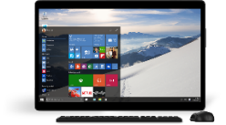
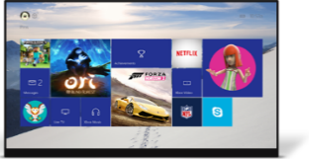
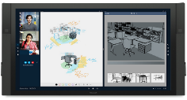
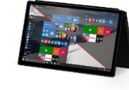
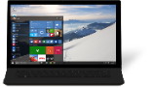
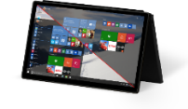
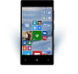
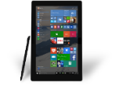
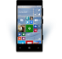


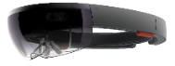








PC
XBox
Mobile
Surface Hub
Devices +IoT
HoloLens
Universal Windows Apps
Multiple device families
Adaptive User Interface
Reuse Existing Code
Natural User Inputs
One Store + One Dev Center
One SDK + Tooling
One Universal Windows Platform

Slide 11
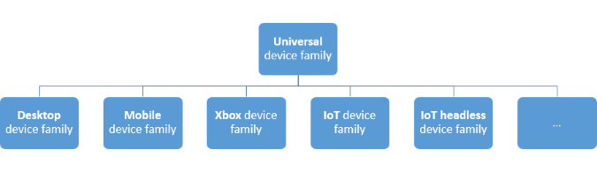
Dev
create a single app package
Unified Developer Platform - 統一開發平台
provides a guaranteed core API layer across devices
Adaptive Code
across all device types

Slide 12
Dev
Windows 10
Windows 8.1
Windows Server 2012 R2
Windows 7
Best developer experience for building Universal Windows apps
Deploy/Debug/Profile
Simulator
Local Machine
Mobile Emulators
Remote Machine
Device
XAML Designer/Intellisense
All other features work at parity with Windows 10, except:
Deploy/Debug/Profile
Mobile Emulators
Remote Machine
Device
XAML Intellisense
No WACK (Server R2)
All other features work at parity with Windows 10, except:
Deploy/Debug/Profile
Remote Machine
Device
XAML Intellisense

Slide 13
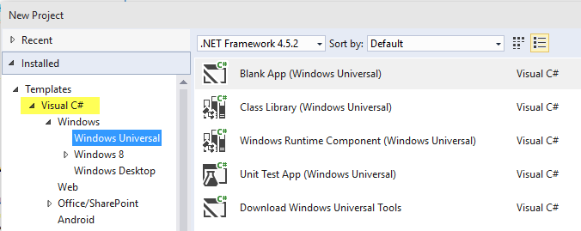
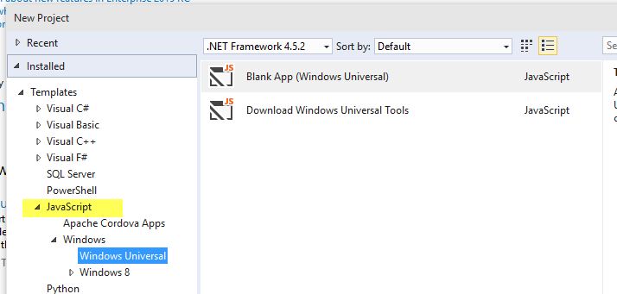
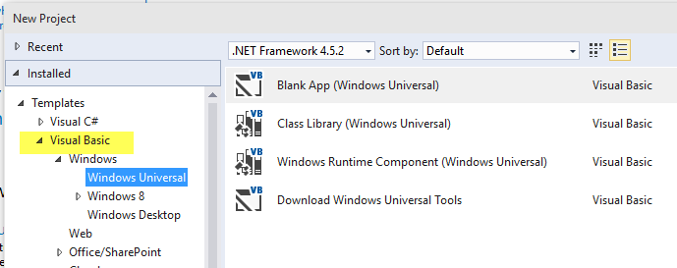
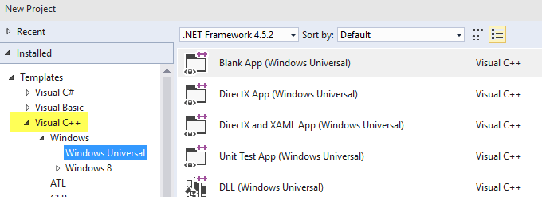
Dev
C++, C#, Visual Basic, and JavaScript
DirectX , XAML, Html

Slide 14
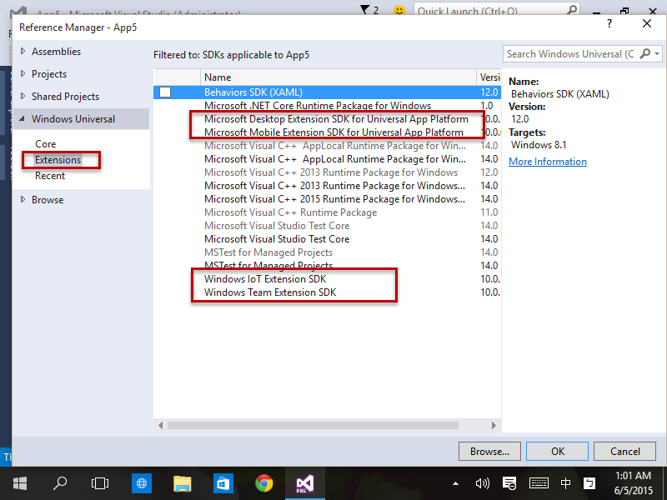
Dev
Add Extensions

Slide 15
Dev
Windows.Foundation.Metadata.ApiInformation
IsTypePresent
bool isHardwareButtonsAPIPresent =
Windows.Foundation.Metadata.ApiInformation.IsTypePresent
("Windows.Phone.UI.Input.HardwareButtons");
if (isHardwareButtonsAPIPresent)
{
Windows.Phone.UI.Input.HardwareButtons.CameraPressed
+= HardwareButtons_CameraPressed;
}

Slide 16
Dev
Windows.Foundation.Metadata.ApiInformation
IsTypePresent,IsEventPresent, IsMethodPresent, IsPropertyPresent,IsApiContractPresent
bool isHardwareButtons_CameraPressedAPIPresent =
Windows.Foundation.Metadata.ApiInformation.IsEventPresent
("Windows.Phone.UI.Input.HardwareButtons", "CameraPressed");

Slide 17
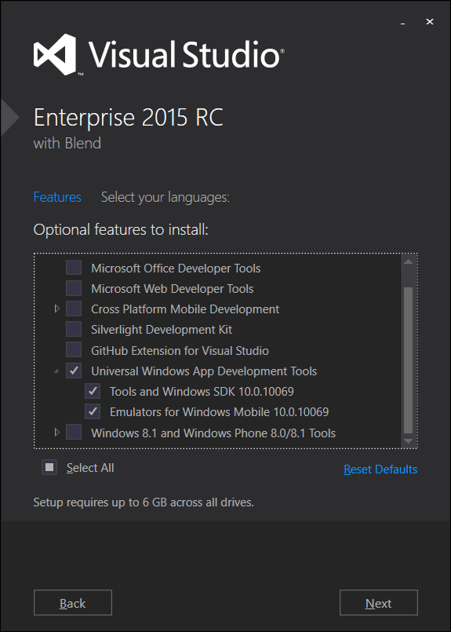

Dev
Notes:
Project
Hello Win 10
Windows Device Family Extension SDK

Slide 18
Ref
http://channel9.msdn.com/Series/A-Developers-Guide-to-Windows-10
http://www.microsoftvirtualacademy.com/training-courses/a-developers-guide-to-windows-10

Slide 19
Universal Windows Platform Bridge

Slide 20


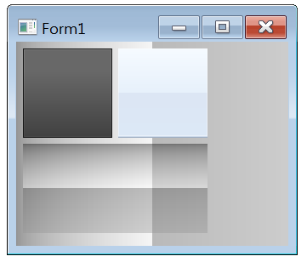

UWP Bridge
project-astoria
project-islandwood
Project Centennial
Project Westminster
Windows 10 UWP

Slide 21
Project Astoria (java)
最大程度的Reuse code - Build Windows apps for phones with few code changes
Use a Microsoft interoperability library
Test and debug your app from your preferred IDE
部份Android UI會轉換為Windows Phone原生UI (Not 100%)
使用java直接呼叫Windows Phone專用API(動態磚)
https://dev.windows.com/en-US/ProjectAPreviewSignup

Slide 22
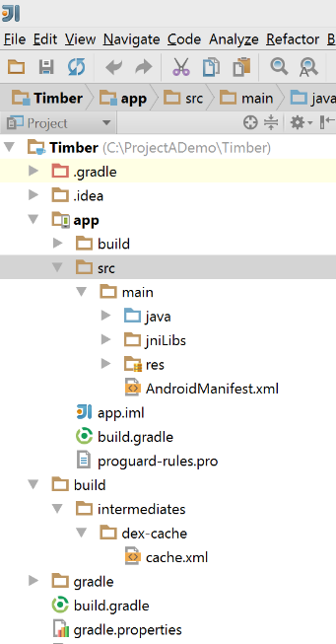
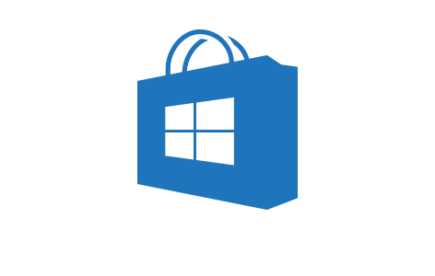


Project Astoria (java)
https://dev.windows.com/en-US/ProjectAPreviewSignup
Your Android Code
(Project Astoria SDK & App analysis)
Your IDE
(Project Astoria Plugins)
Your dev
machine
Windows
Magic
Your app in the Windows Store
IntelliJ
Android
Studio
Eclipse
Live tiles
Windows
Mac
+
+
+
…

Slide 23
Project Islandwood (Objective c)
Import Xcode® projects into Visual Studio
Build and debug your Objective-C code from Visual Studio
future - support Swift
Success project - Candy Crash Saga
https://projectipreviewsignup.windows.com/

Slide 24
Ref
https://dev.windows.com/zh-TW
https://github.com/Microsoft/Windows-universal-samples
https://msdn.microsoft.com/zh-tw/library/windows/apps/dn894631.aspx
https://dev.windows.com/en-US/uwp-bridges
https://projectipreviewsignup.windows.com/
http://channel9.msdn.com/Events/Build/2015/2-692

Slide 25
Microsoft Edge

Slide 26


Microsoft Edge
Edge
I am IE
Who am I ?

Slide 27
Microsoft Edge
Project Spartan
New rendering engine Base onTrident 重新改寫
IE11 on Win 10 + for 企業舊系統使用 ( 盡早升級應用系統 )
不再支援IE專用技術(ActiveX、VBScript…)
符合更多HTML5、JavaScript標準

Slide 28

掰掰

Slide 29
New & updated HTML5 features
CSS
@supports Flexbox standards update dppx unit transform-style: preserve-3d Filter effects
Storage & networking
HTTP/2 Content security policy Web Crypto API updates HSTS (HTTP Strict Transport Security
Media & RTC
Media capture HLS WebAudio Video Tracks WAV Audio support
JavaScript
ES6 Math, Number, String, RegExp & Object built-ins Arrow functions, Enhanced object literal, Template strings, Default, Rest, Spread Map, Set, Weakmap, __proto__, Proxies Let, Const, Promises, Classes
DOM & Graphics
SVG foreignobject SVG attribute animation Complete WebGL support DOM event constructors DOM Level 3 XPath
Input & Editing
Touch events Pointer lock API Media Queries L4 - Interaction Selection API Gamepad API
Shipped
Preview Release
In development

Slide 30
Mobile Issues
Use IE redirect to www.xxx.xxx
Use Chrome redirect to www.xxx.xxx/mobile/....
Change User Agent String

Slide 31




Microsoft Edge
Mozilla/5.0 (Windows NT 10.0; WOW64; rv:35.0) Gecko/20100101 Firefox/35.0
Mozilla/5.0 (Macintosh; Intel Mac OS X 10_10_1) AppleWebKit/600.1.25 (KHTML, like Gecko) Version/8.0 Safari/600.1.25
Mozilla/5.0 (Windows NT 10.0; WOW64) AppleWebKit/537.36 (KHTML, like Gecko) Chrome/40.0.2214.93 Safari/537.36
Mozilla/5.0 (Windows NT 10.0; WOW64) AppleWebKit/537.36 (KHTML, like Gecko) Chrome/39.0.2171.71 Safari/537.36 Edge/12.0

Slide 32
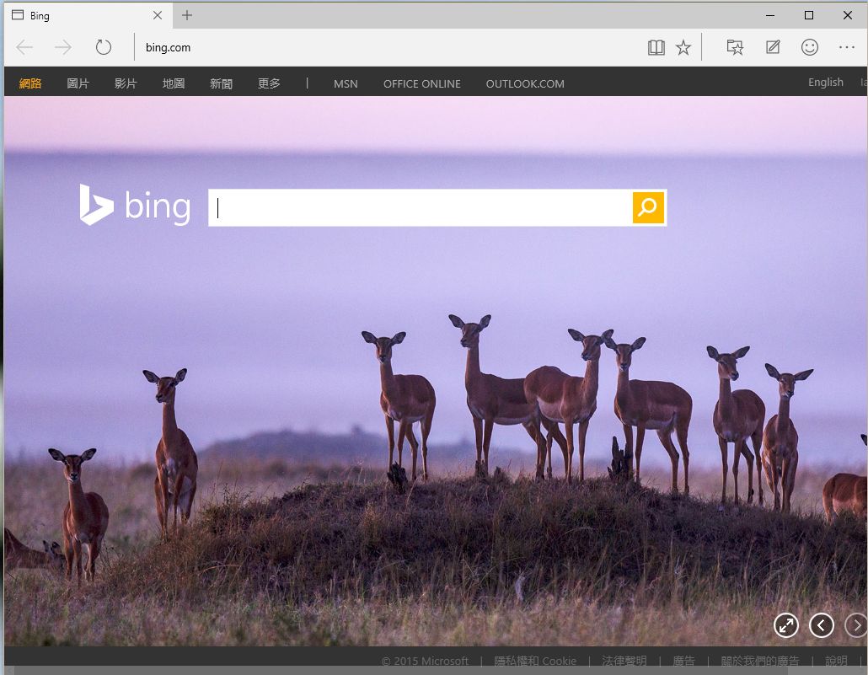
Dev
Notes:
筆記功能
閱讀模式

Slide 33
Visual Studio

Slide 34
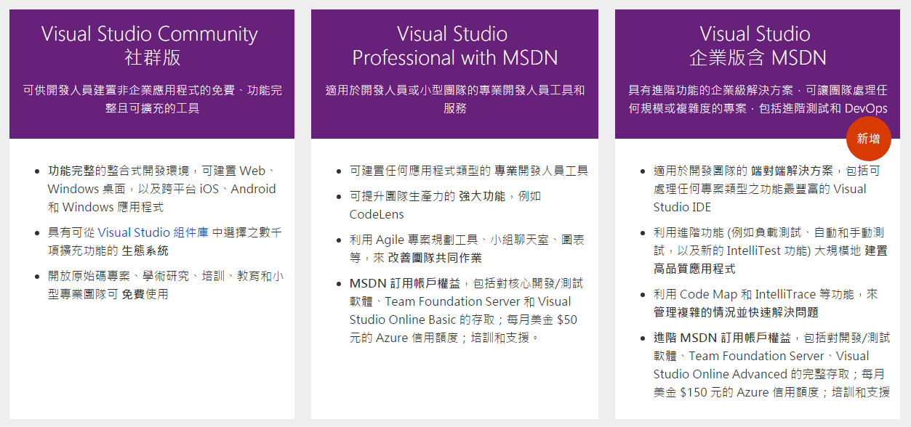
Visual Studio 2015

Slide 35

Visual Studio 2015
https://www.visualstudio.com/products/vs-2015-product-editions

Slide 36
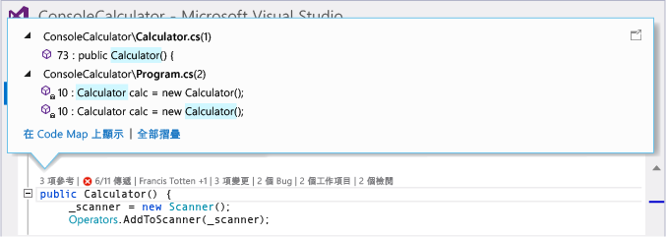
Visual Studio 2015
Visual Studio Tools for Apache Cordova
Visual Studio Emulator for Android
Visual Studio Tools for Universal Windows App Development
Git 版本控制加強
CodeLens

Slide 37
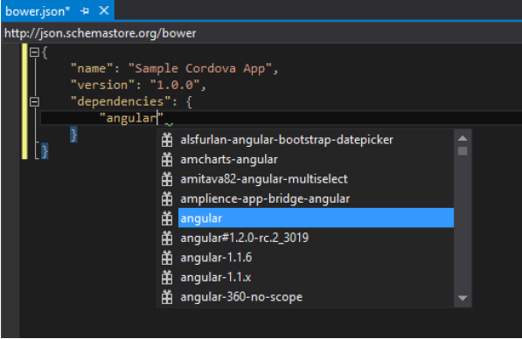

Visual Studio 2015
Support bower package manager
bower.json
bower install
bower_components folder

Slide 38
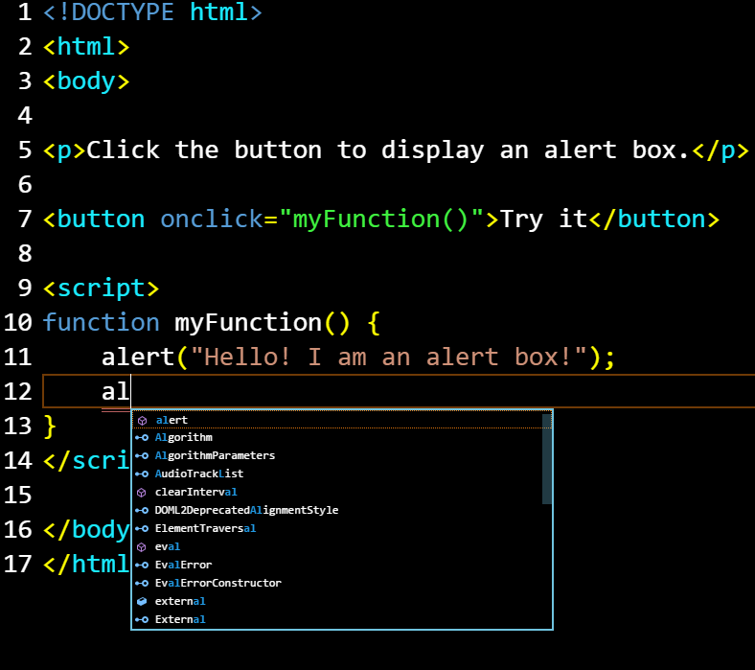



Visual Studio Code
Editor
Support
Intellisense
Version Control - Git
https://code.visualstudio.com

Slide 39
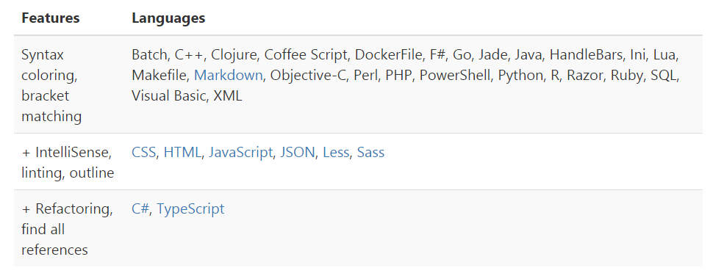
Visual Studio Code

Slide 40
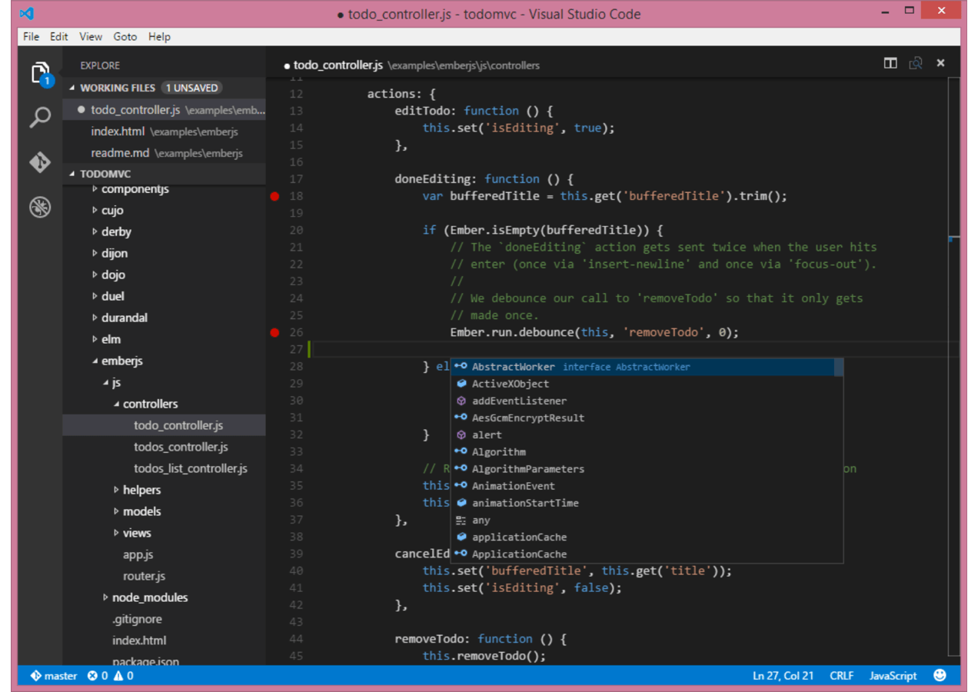
Dev
Notes:
Demo Intellisense
Demo command line
Demo Customization

Slide 41
Ref
https://code.visualstudio.com/Docs/

Slide 42
Cross Platform App Tool

Slide 43
Hybrid App
Native APP
Web APP
Hybrid APP

Slide 44
Hybrid App
Cross platform
Fast - Web to app
對講求高效的app較不合適(Game、3D)
UI驗體較無法發揮平台特性

Slide 45
Hybrid App Dev
PhoneGap / Cordova
written once，run everywhere
跨平台通用的JavaScript API
Titanium
針對特定平台制定API，追求提供平台特性的使用者體驗
使用特定的IDE開發工具

Slide 46









Cross Platform App Dev
CSS | HTML
JavaScript | TypeScript
Native UI
Native UI
Native UI
C# + XIB
C# + AXML
C# + XAML
Shared client app logic
in C#
Black Box

Slide 47

Visual Studio Tools for Apache Cordova
Build apps for iOS, Android, and Windows
Build mobile apps using HTML, CSS, and JavaScript
Flexibility to use any JavaScript framework
Native device access with support for common and custom plug-ins exposed as JavaScript APIs
https://www.visualstudio.com/en-US/explore/cordova-vs

Slide 48
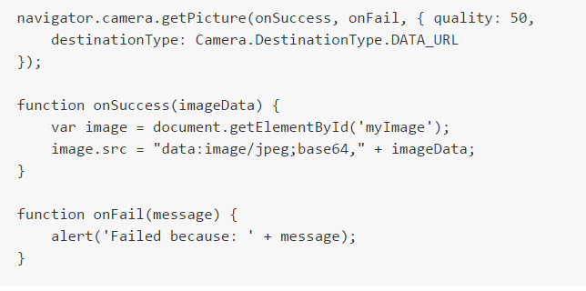
Visual Studio Tools for Apache Cordova
封装Native的功能，提供跨平台一致性Device API
將Html、CSS、JavaScript 打包成APP

Slide 49


User Experience
Application Logic
HTML & CSS
JavaScript
or
TypeScript
Open-source front-end frameworks
AngularJS
BackboneJS
WinJS
Mobile Platform Development
Apache™
Cordova
Geolocation
Apache™ Cordova
Plugins Registry
Media
File System
http://plugins.cordova.io
Examples of plugins for interfacing with device capabilities
Microsoft Services
Custom API’s
Active Directory,
Office 365
RESTful end-points
Azure Mobile Services, Web API, etc.

Slide 50
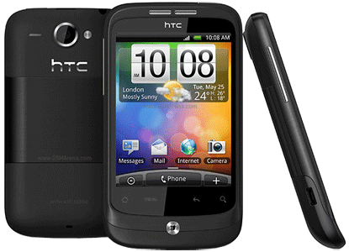
Visual Studio Tools for Apache Cordova
Android
Physical device
New Visual Studio Android Emulator
Android Emulator, belonging to the Android SDK
Apache Ripple Emulator

Slide 51
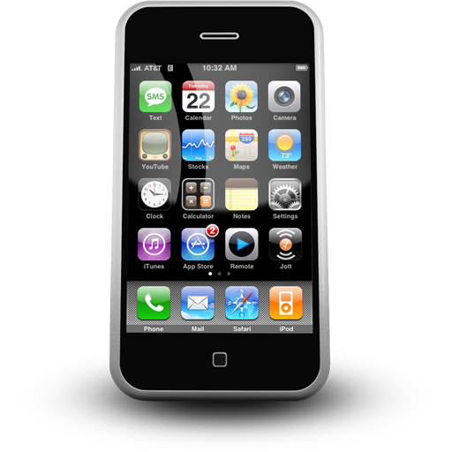
Visual Studio Tools for Apache Cordova
iOS
Physical device
iOS Emulator
Apache Ripple Emulator

Slide 52
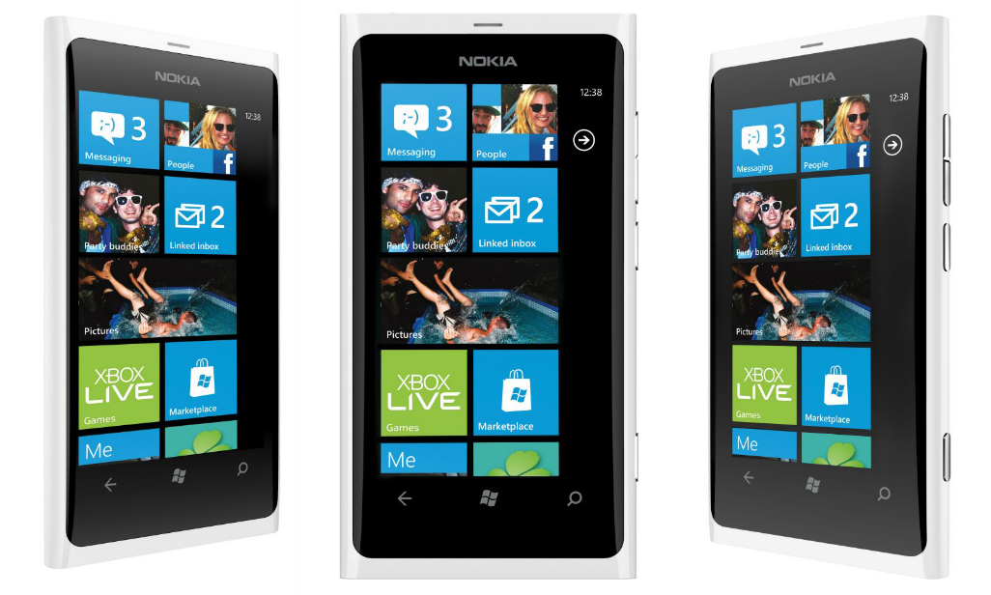
Visual Studio Tools for Apache Cordova
Windows
Physical device
Visual Studio emulators for Windows Phone and Windows

Slide 53
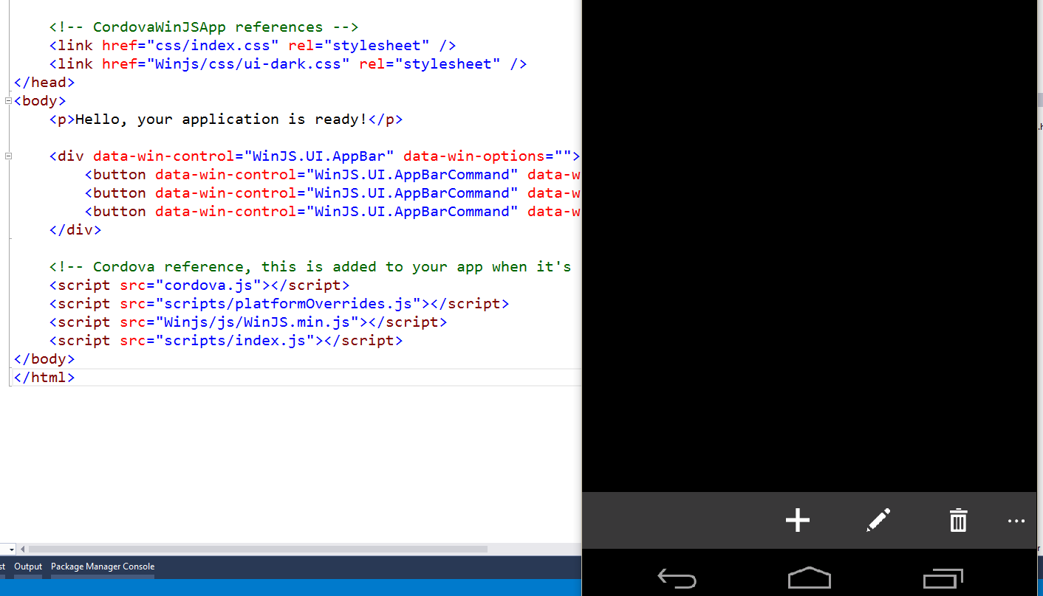
Dev
Notes:
Project Template
+bootstrap
+Winjs

Slide 54
Ref
https://www.visualstudio.com/en-us/features/cordova-vs.aspx
https://msdn.microsoft.com/zh-tw/library/dn879821(v=vs.140).aspx

Slide 55

FAQ

Slide 56
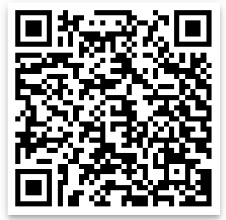
//Build// Mini 2015 課後問卷
每週三會有常態性聚會活動 (於星巴克裕誠店，近巨蛋捷運站)

Slide 57
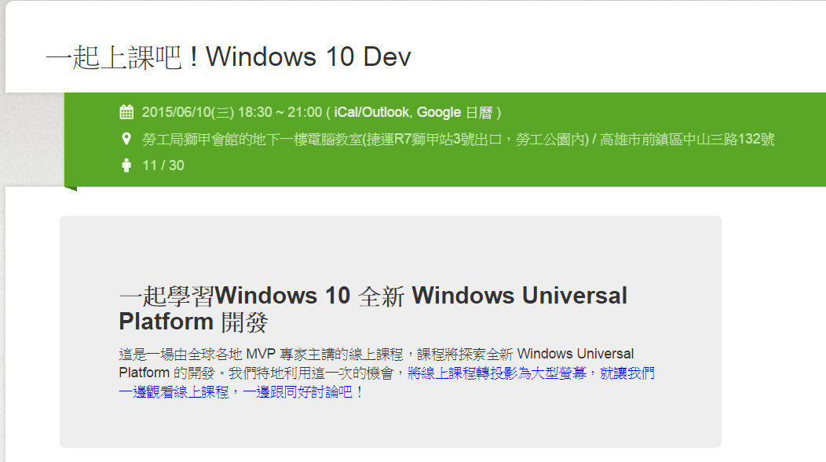
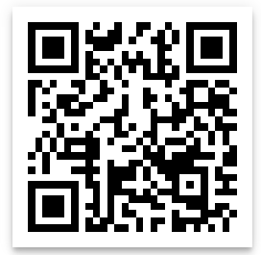
活動預告

